Slide 1
Methods for changing scenes
FOR SCENE DESIGNERS

Slide 2
Flown scenery

Slide 3
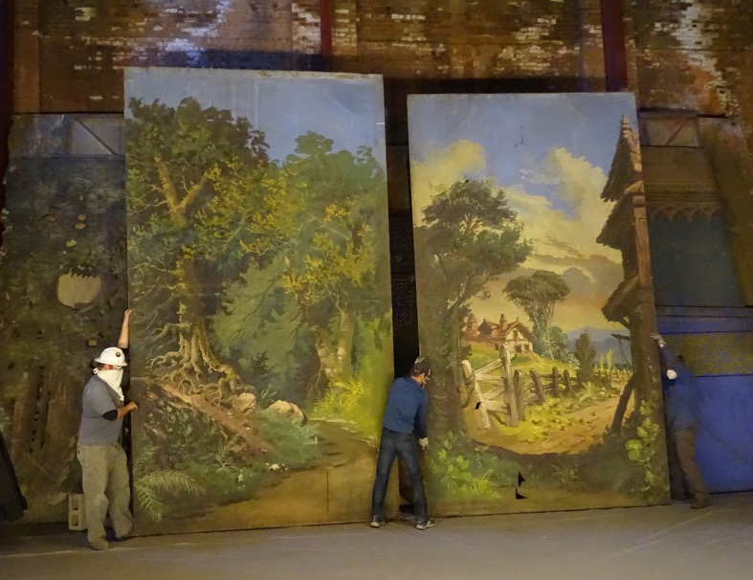
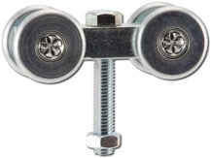
Scenery on tracks

Slide 4
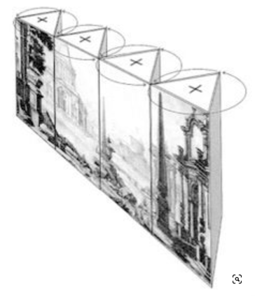
Periaktoi

Slide 5
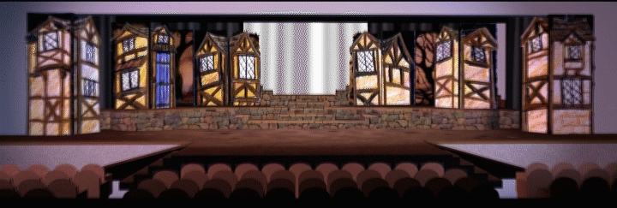
Storybook panels
borrowed from https://scenicandlighting.com/article/multi-page-storybook-panels/

Slide 6
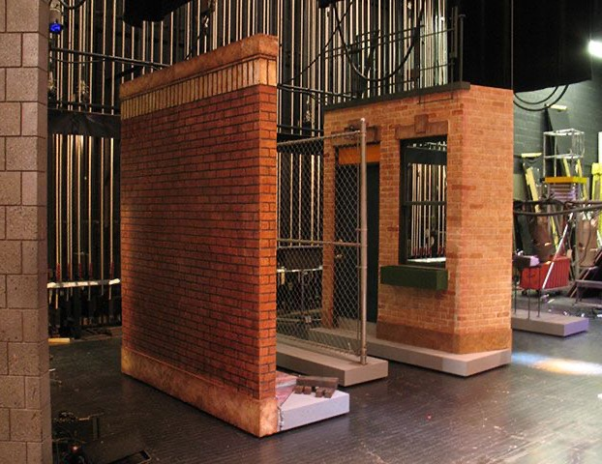
Wagons

Slide 7
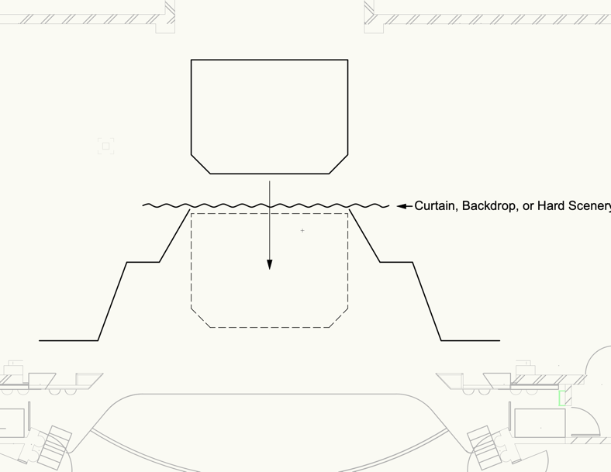
Slip stages

Slide 8
Jack knifes
https://youtu.be/XviYhLDQ0QY?si=H-MSs5LOkRQruA-w&t=36

Slide 9
Turntables

Slide 10
Double turntables

Slide 11
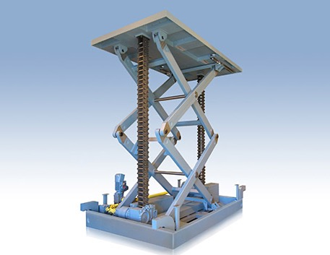
Elevators
https://youtu.be/FKR78ZchDbE?si=X_ElarxYRP8iBvbT

